Slide 1
Page Rank Algorithm

Slide 2
used by Google Search to rank websites in their search engine results.
named after Larry Page, one of the founders of Google.
a way of measuring the importance of website pages.

Slide 3
Page 4 Page 3
Popular Algorithms to rank webpages:
HITS : Hypertext Induced Topic Search
Page Rank
Model to represent webpages in the form of directed graph:
Nodes : web pages
Directed edges : hyperlinks
Page 1 Page 2

Slide 4
Basic Concept behind Page Rank algorithm
Works by counting the number and quality of links to a page, to determine a rough estimate of how important the website is.
The underlying assumption is that more important websites are likely to receive more links from other websites.

Slide 5
Types of Links
Inbound Link → links into given site from outside i.e., from other pages.
Outbound Link → links from given page to pages in the same site or other sites.
Dangling Link and nodes → no outgoing links.

Slide 6
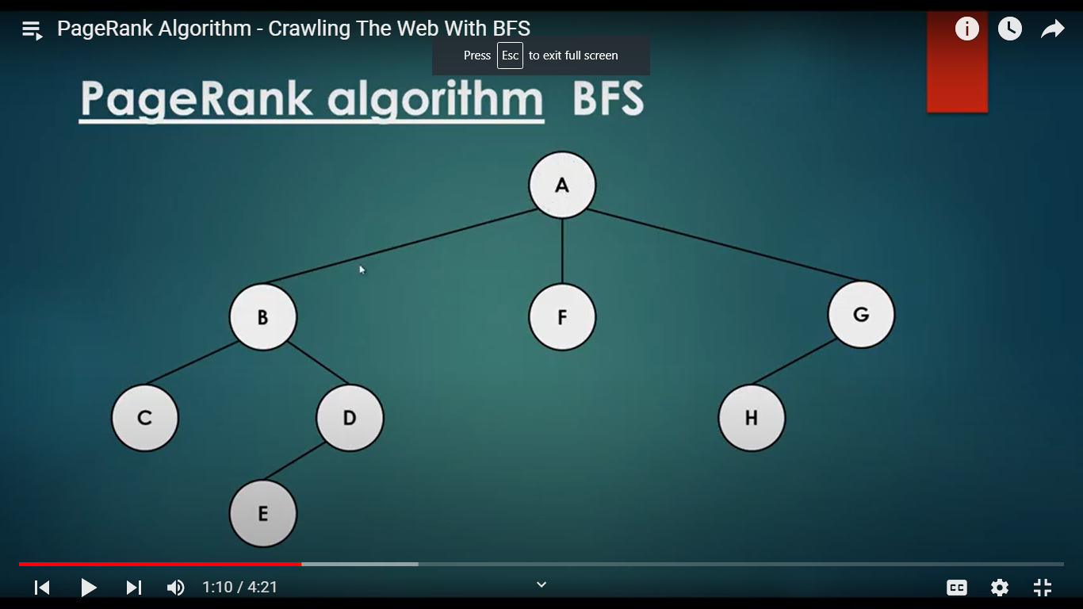
Page rank algorithm
First, know the topology of the world wide web.
Several methods to traverse graph:
Breadth-first search
Depth-first search

Slide 7

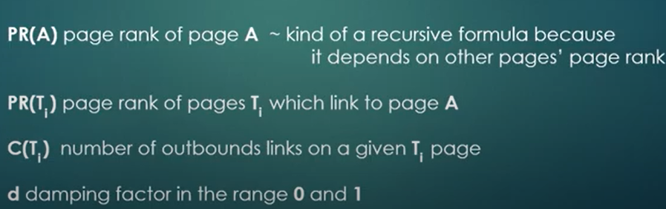
Equation for Page Rank algorithm

Slide 8

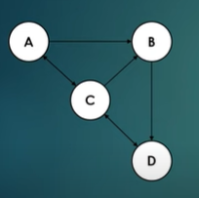
Iterative formula
Example
 | Iteration 0 | Iteration 1 | Iteration 2 | Page Rank
A | 1/n = ¼
B | 1/n = 1/4
C | 1/n = 1/4
D | 1/n = 1/4

Slide 9
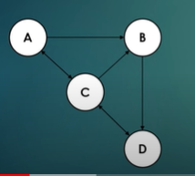
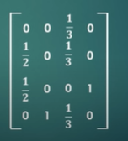
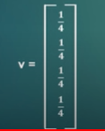

Matrix Representation

Slide 10
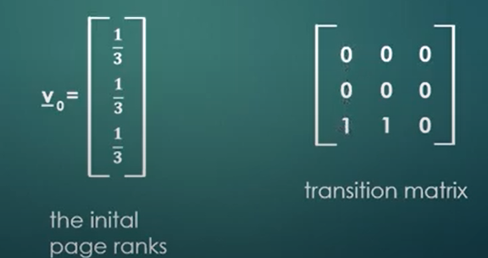
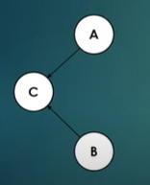
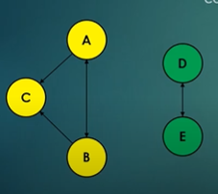
Problems
Dangling nodes
Several disconnected, independent components

Slide 11
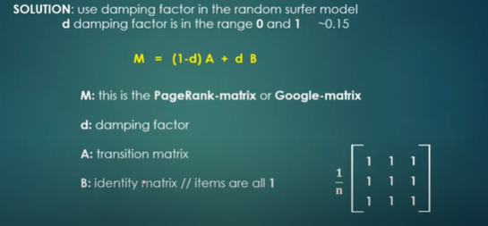
Final Formula

Slide 12
Page Ranker’s Algorithm using python:-
Every webpage in google is stored as a node in a graph.
Every edge that is linked/directed to other node is the hyperlink in that webpage.
Based on this the graph looks like (figure—next slide).
For Implementation purposes, we are using 25 nodes. There will be trillions of edges connected to the graph used by google.

Slide 13
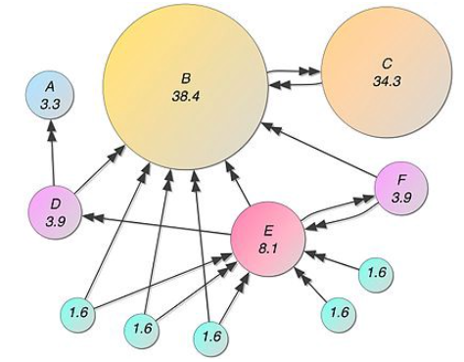

Slide 14
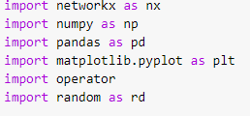
First import necessary libraries for this implementation

Slide 15
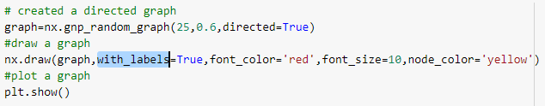
Generate a graph with 25 nodes using networkx library. Here we are setting probability as 0.6 which is the probability of having edge between 2 nodes in a graph.

Slide 16

Store no of nodes and neighbors of a particular node which will be required for further implementation of the algorithm.

Slide 17
Generate a random walk score for each and every node by starting with a random node and doing a walk through its neighbor nodes and increasing score. Now for implementation, we are iterating the process for 500000 times.

Slide 18
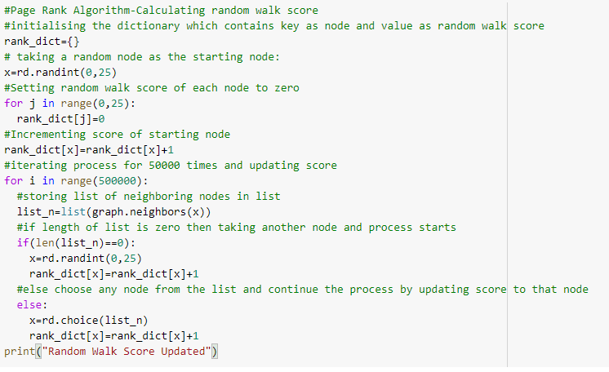

Slide 19


Once we got the scores stored in the dictionary we need to normalize score by dividing the random walk score by no of iterations
Let's get the random scores for the graph by using built-in function pagerank in networkx library and sort the obtained dictionary based on the scores.

Slide 20
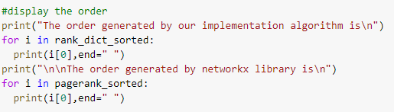
Now sort the dictionary we generated by an algorithm and store it.
compare both results

